Slide 1
Secondary Activity: Manufacturing
Chapter
18
Learning outcomes: 2.5

Slide 2
At the end of this chapter, you will be able to:
18.1 Describe what is meant by ‘secondary activities’.
18.2 Describe the factors affecting the location of industry.
18.3 Describe how Apple functions as a system.
18.4 Explain why Apple located in Ireland.
18.5 Describe how Apple operates sustainably.

Slide 3
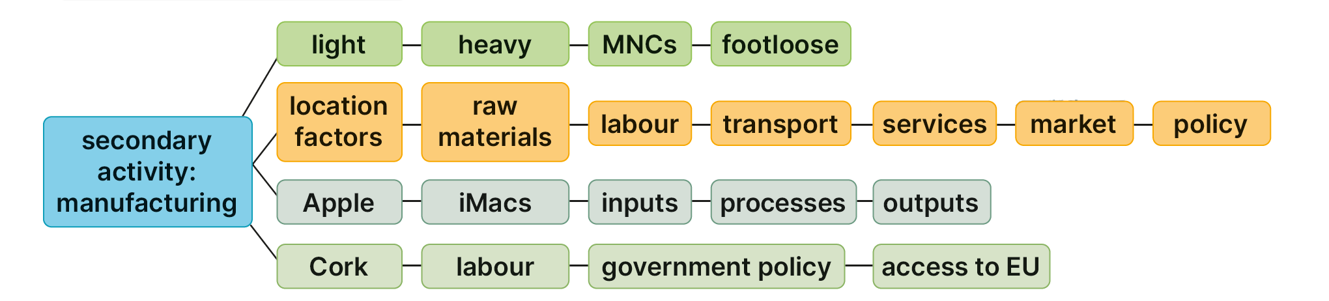
Keyword connections

Slide 4
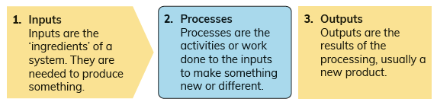
18.1 Describe what is meant by ‘secondary activities’.
Secondary Activities
Secondary economic activity another name for manufacturing.
Manufacturing involves making physical goods.
Manufacturing always works according to a system
Inputs are processed or changed into outputs or finished products.
Examples of manufacturing include
Baking
Computer manufacturing.
Most manufacturing takes place in factories.

Slide 5
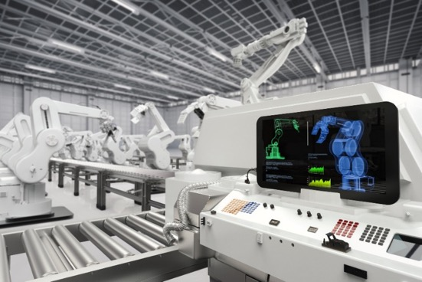
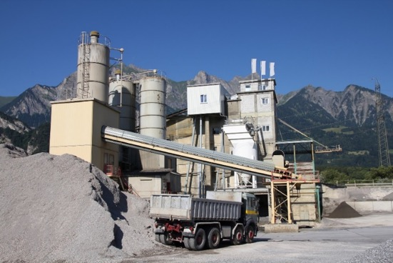
18.1 Describe what is meant by ‘secondary activities’.
Types of Industry
Light industry
Uses light raw materials
Produces goods that are small, light and easy to transport, e.g. electronics and textiles
Apple is an example of a light industry.
Heavy industry
Uses heavy machinery and raw materials
Produces goods that are heavy and bulky, e.g. cement and steel
Aughinish Alumina is an example of a heavy industry.

Slide 6
18.1 Describe what is meant by ‘secondary activities’.
Types of Industry
Multinational corporation (MNC)
Business that has factories and offices in many locations across the world
Apple is an example of an MNC.
Its headquarters are located in Cupertino, California, USA and it has operations in many countries, including Ireland.
Footloose industries
An industry that is not tied to a particular location and can move easily.
Computer manufacturing and pharmaceuticals are examples of footloose industries.

Slide 7

18.1 Describe what is meant by ‘secondary activities’.
1. What are the three main parts of a system?
2. What word endings (suffixes) tell you a word is a process word?
3. Are heavy industries footloose? Explain your answer.
4. Why is a light industry called a light industry?
5. What is a finished product?

Slide 8
18.1 Describe what is meant by ‘secondary activities’.
Higher-order questions 1
1. Heavy, light, footloose: How many other types of industry can you think of?
2. How many multinational companies can you think of? Are there any located near your home or school?
3. Can you think of any manufacturing activities that are linked? For example, flour is the output of milling (flour manufacturing). It is an input of baking. What other examples can you think of?

Slide 9
18.1 Describe what is meant by ‘secondary activities’.
Go to Section 18.1 on page 96 of your Skills Book.

Slide 10
18.2 Describe the factors affecting the location of industry.
Types of location
Industrial estate
A dedicated area for factories located on the outskirts of a town
Close to good transport links and a labour supply
Has all the services factories need, such as water, waste disposal and electricity
Industrial inertia
When an industry stays in a location, even though it would make better business sense to move somewhere else
Example: Sheffield Iron and Steel in Great Britain.
Greenfield site
Location where nothing has been built before
It is often one or more fields near a town which may not have had any factories previously.

Slide 11
18.2 Describe the factors affecting the location of industry.
When describing the factors that affect (influence) the location of industry, make sure to include the word ‘locate’ or ‘location’ in your answer.
For example, instead of writing:
‘An industry needs raw materials. It needs the raw materials to manufacture its products.’
Write this:
‘An industry needs raw materials to manufacture its products. The industry should locate close to its raw materials to keep the cost of transporting them low.’

Slide 12
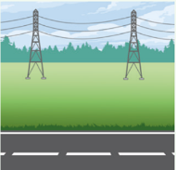
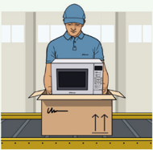


18.2 Describe the factors affecting the location of industry.
Serviced land
A factory must locate where services are available; manufacturing companies locate in industrial zones or estates.
Labour supply
Factories often locate close to towns and cities where there is a ready supply of labour.
Capital
Companies like to set up (locate) near banks, investors and the government because this makes it easier to access and negotiate capital for their business.
Raw materials
A factory must consider locating close to the source of the raw materials to reduce transport costs, especially if they are very bulky.

Slide 13
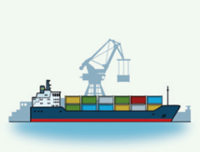


18.2 Describe the factors affecting the location of industry.
Transport facilities
A factory must locate close to good transport routes so that they can have raw materials delivered and their finished products shipped as cheaply and efficiently as possible.
Markets
Factories must consider locating close to their market to reduce transport costs.
Government policy
The Irish government tries to encourage factories to locate in Ireland because this creates jobs.

Slide 14


18.2 Describe the factors affecting the location of industry.
European Union (EU) policy
Foreign companies like to locate in Ireland so that they can take advantage of the free trade within the EU.
Preferences of investors and the local community
Entrepreneurs may prefer some locations over others. Local communities may object or support a factory locating in their area.

Slide 15
18.2 Describe the factors affecting the location of industry.
Activity
Examine the map opposite.
You are trying to decide where to locate your factory.
Choose a suitable location (use a grid reference).
Explain three reasons for your choice of location.

Slide 16

18.2 Describe the factors affecting the location of industry.
1. What is a greenfield site?
2. What is meant by the term ‘market’?
3. What is an industrial estate?
4. Why is transport an important factor for industries?
5. Why is the European Union important for industry in Ireland?

Slide 17
18.2 Describe the factors affecting the location of industry.
Higher-order questions 2
1. Are some of the factors that affect location more important than others? Which ones and why?
2. Factories should avoid locating near which locations?
3. Ireland has not enough coal, oil or iron ore for major industry to develop. How do you think Ireland adapted to this?

Slide 18
18.2 Describe the factors affecting the location of industry.
Go to Section 18.2 on page 97 of your Skills Book.

Slide 19

18.3 How Apple Functions as a System
Apple is an electronic devices and services company.
Manufactures iPhone, iMac, MacBook and iPod devices
Creates software such as iTunes and OS X to run on its devices.
Opened a factory in Hollyhill in Cork in 1980
employs over 6,000 people in Cork
Many thousands more jobs are supported directly as suppliers to Apple
Thousands more are supported indirectly, e.g. in shops and local businesses that benefit from the income earned by Apple workers.
The Hollyhill plant manufactures iMacs – Apple’s range of desktop computers.

Slide 20

18.3 How Apple Functions as a System
Processes
Components are picked out and placed on the assembly line.
Workers assemble components into the computer enclosure (case).
The operating system is installed and the computer is tested to make sure it works correctly.
The computer is packaged and shipped.
Inputs
High-tech factory
Qualified and skilled workers
Services
Computer components
M1 System on a Chip, hard drive/SSD, screen, case
Image: Claudio Caridi/Shutterstock.com

Slide 21

18.3 How Apple Functions as a System
1. Why do some factories locate in industrial estates?
2. What is meant by the ‘functions’ of an industry?
3. List three inputs and three processes used by Apple in making iMacs.
4. What finished product does Apple manufacture in Cork?
5. Describe two ways in which Apple is important to Cork.

Slide 22
18.3 How Apple Functions as a System
Higher-order questions 3
1. Most of the time spent building a computer involves testing it after the components have been assembled. Why does testing take up most of the time to build the computer?
2. Why is it important for Apple’s manufacturing to operate as a system?
3. Why is skilled labour important to Apple’s manufacturing?

Slide 23
18.3 How Apple Functions as a System
Go to Section 18.3 on page 98 of your Skills Book.

Slide 24
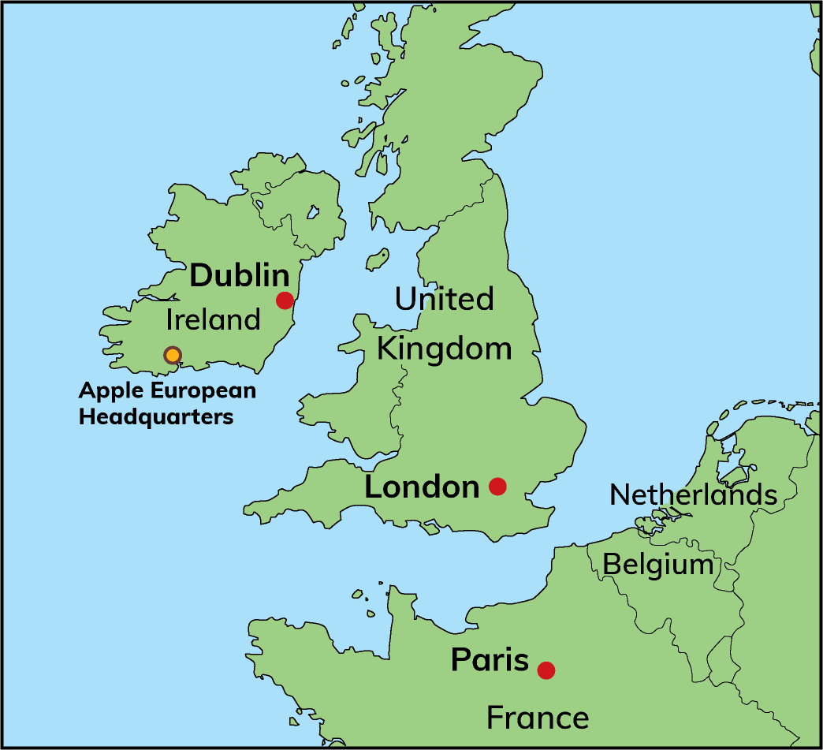
18.4 Explain why Apple located in Ireland.
Apple is an example of a light industry.
The Hollyhill factory is the only completely Apple-owned factory in the world, outside of the United States.
Hollyhill is Apple’s headquarters for the Europe, Middle East and Africa (EMEA) region.
Apple located in Ireland for several reasons.

Slide 25
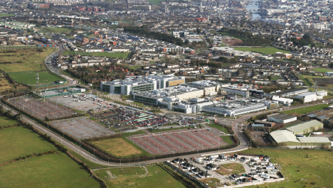
18.4 Explain why Apple located in Ireland.
Labour
Third-level colleges produce highly skilled graduates in computing, electronics and manufacturing.
Ireland is the only member of the EU with English as the majority maternal language.
Ireland is attractive to Apple, because English is the global language of business and the internet.
Government policy
Apple received training grants, grants for building their factory and tax incentives to locate in Ireland.
MNCs only pay 12.5 per cent tax in Ireland compared to 35 per cent in many EU countries.
Access to Europe
Ireland is a member of the EU.
By locating in Ireland, Apple can sell within Europe without incurring tariffs.
The base in Ireland also gives Apple easier access to a market of 700 million people.

Slide 26
18.4 Explain why Apple located in Ireland.
Go to Section 18.4 on page 98 of your Skills Book.

Slide 27
18.5 Describe how Apple operates sustainably.
In the past, when used electronics were being disposed of, they often went into landfill, where they caused pollution.
In some cases, electronic waste was exported to countries such as Ghana or India, where they were melted down for their metals, such as copper and gold.
This also caused pollution and has been linked to poor air quality that affected workers’ health.
All industries produce waste.
Some waste can be recycled.
A lot of waste is sent to landfill sites or to an incinerator.
Waste costs money and affects the environment, so all industries try to reduce the amount of waste they produce.

Slide 28
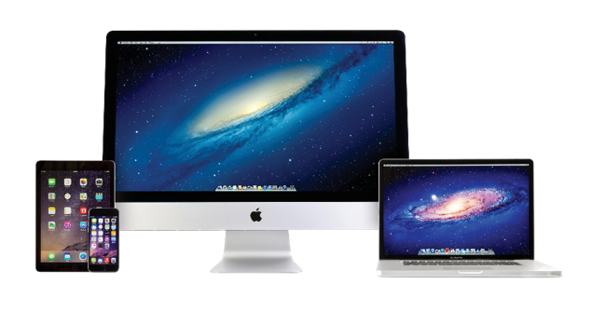
18.5 Describe how Apple operates sustainably.
Sustainable manufacturing
Apple has an extensive environmental programme and continuously strives to reduce its impact on the environment.
Almost all the electricity used by Apple globally is generated from renewable sources.
Apple’s buildings harvest rainwater and use solar paneling to generate electricity.
Apple has been reducing the number of materials used in its products.
Apple has a buyback programme for old Apple computers. If a computer cannot be reused (for example, refurbished), it is recycled. Apple uses materials such as aluminium and glass, which are easily recycled.
Apple has also planned for its manufacturing to be completely carbon neutral by 2030.
Apple uses materials such as aluminium and glass, which are easily recycled.

Slide 29

18.5 Describe how Apple operates sustainably.
1. What is an MNC? Name one example.
2. Why did Apple choose to locate in Ireland?
3. What is waste and why should we reduce it?
4. What is sustainable manufacturing? Why is it important?
5. Describe three ways Apple acts sustainably.

Slide 30
18.5 Describe how Apple operates sustainably.
Higher-order questions 4
1. Explain why it is important to reduce, reuse and recycle resources.
2. Apple plan to be carbon neutral by 2030. What does ‘carbon neutral’ mean?
3. Why do companies like Apple try so hard to reduce waste?

Slide 31
18.5 Describe how Apple operates sustainably.
Go to Section 18.5 on page 99 of your Skills Book.

Slide 32

The learning outcome for this topic requires you to ‘describe a local secondary activity in relation to its function and the factors that influence its location’.
One of the tasks you need to be able to demonstrate is to write about how a manufacturing activity works as a system, and you have to be able to write about how its location was affected by particular factors.
One way to approach learning this topic is do study it through your CBA2.
There is a CBA2 Warm-Up on pages 225–226 of your Textbook. Follow your teacher’s advice. It may not be possible or suitable for this – another CBA2 might be more suited to your class and school.

Slide 33
Assess your progress
Go to page 99 of your Skills Book and assess your progress.
18.1 Describe what is meant by ‘secondary activities’.
18.2 Describe the factors affecting the location of industry.
18.3 Describe how Apple functions as a system.
18.4 Explain why Apple located in Ireland.
18.5 Describe how Apple operates sustainably.
Identify any gaps in your learning. Use the Rapid Revision on page 227 of your Textbook to jog your memory.

